Slide 1
Cross-Platform Mobile Application Development with Xamarin
Module 3, Lesson 4:
Developing Android Apps with Xamarin
Notes:
Images and excerpts from Xamarin Mobile Application Development by Dan Hermes, published by Apress
http://www.mobilecsharpcafe.com/xamarin-book/

Slide 2
Topics
Coding for Android using C#
Android development fundamentals:
Activity
Life Cycle
Layouts
Views/Controls
Android user interfaces

Slide 3
Objectives
In this lesson you will learn about:
Building an Android application using Xamarin.Android
Basic Android development concepts
User interfaces on the Android platform

Slide 4
How Does a C# App Talk to Android?
Xamarin.Android is a C# binding to the Android SDK
Android devices contain the Linux kernel
Android Runtime (ART) exposes APIs to device
Android.*, Java.* namespaces
Xamarin.Android provides bindings to these APIs
Calls to bindings compile to pass-throughs to API calls
Notes:
References:
Xamarin.Android architecture: https://developer.xamarin.com/guides/android/under_the_hood/architecture/
ART: https://source.android.com/devices/tech/dalvik/
Android and the Linux kernel: http://www.howtogeek.com/189036/android-is-based-on-linux-but-what-does-that-mean/

Slide 5
Activity
Main building block of Android applications
C# class containing a single user action
Often found behind a full-screen layout (or View)
Acts as a Controller or View-Controller
At least one must be declared as the application’s entry point
Notes:
References:
Activities: http://developer.android.com/reference/android/app/Activity.html

Slide 6
Main Activity
[Activity(Label = "MyActivity", MainLauncher = true, Icon = "@drawable/icon")]
public class MainActivity : Activity
{
protected override void OnCreate(Bundle bundle)
{
base.OnCreate(bundle);
// Set view from the "Main" layout resource
SetContentView(Resource.Layout.Main);
// Set up Layout and event handler code here
}
}
Notes:
Notes:
The Main Activity is made to be the startup activity with by setting MainLauncher = true in the Activity’s attribute.

Slide 7
Android Activities: Lifecycle
Activity Running
Activity Paused
Activity Backgrounded
Activity Stopped
Notes:
Notes:
The next few slides will explain each area.

Slide 8
Android Activities: Running
In the foreground
Top of activity stack
Highest priority activity
Activity Running
Activity Paused
Activity Backgrounded
Activity Stopped

Slide 9
Android Activities: Paused
When device goes to sleep
Activity is visible but hidden
Non-full-sized
Transparent activity
Still alive
Maintains state and member information
Remains attached to window manager
Second highest priority activity
Activity Running
Activity Paused
Activity Backgrounded
Activity Stopped

Slide 10
Android Activities: Backgrounded
Completely covered by another activity
Retains state, member information
Lowest priority of the three active states
Activity Running
Activity Paused
Activity Backgrounded
Activity Stopped

Slide 11
Android Activities: Stopped
Inactive
Will be garbage collected quickly
Activity Running
Activity Paused
Activity Backgrounded
Activity Stopped
Notes:
References:
Garbage collection: https://developer.xamarin.com/guides/android/advanced_topics/garbage_collection/

Slide 12
Android State Events: Launch
Upon launching an activity, three state events are fired
OnCreate
OnStart
OnResume
Notes:
References:
Activity state: https://developer.xamarin.com/guides/android/application_fundamentals/activity_lifecycle/saving_state_walkthrough/

Slide 13
Activity: OnCreate
protected override void OnCreate(Bundle bundle)
{
base.OnCreate(bundle);
// Set our view from the "main" layout resource
SetContentView(Resource.Layout.Main);
// Get our button from the layout resource and attach an event to it
Button button = FindViewById<Button>(Resource.Id.MyButton);
button.Click += delegate { button.Text = $"{count++} clicks!"; };
}
Notes:
Notes:
When you click the button, the text on the button will say how many times it’s been clicked.
This is the default code from the empty Android project’s MainActivity.cs file
References:
OnCreate event handler: https://developer.xamarin.com/guides/android/application_fundamentals/activity_lifecycle/#OnCreate

Slide 14
Android State Events: Switching
Upon launching new activity
First activity’s OnPause event fired
Then same events from launch are fired for new activity
OnCreate
OnStart
OnResume
Then first activity’s OnStop event fired

Slide 15
Android State Events: Restarting
Upon restarting an event
Any other active activity’s OnPause event is fired
Three events of restarted activity are fired
OnRestart
OnStart
OnResume
Then two of newly paused activity’s states are fired
OnStop
OnDestroy
Notes:
Notes:
Restarting may occur when clicking Android’s back button to go back to a previous state, for example.

Slide 16
Android Activity: Finish()
Close the current activity and return to the previous activity
Finish() is a method of the Activity
Activity.Finish();
Usually called within the Activity
Finish();

Slide 17
User Interfaces
.axml files located in ../Resources/Layout/
Content tab: drag and drop controls
Source tab: edit XML directly
../Resources/
One root item, typically
a Layout, linear, relative, grid, tab...
Can hold child items to build out UI
.cs file loads .axml file
Put logic in activity’s .cs file
Handles events of .axml file’s elements
Wikis/Blogs
Notes:
Notes:
Drag and drop controls from the toolbox in the designer tab or write XML in the source tabs.
Changes in one are reflected in the other automatically.
References:
Android UI guide: https://developer.xamarin.com/guides/android/user_interface/
Layouts: https://developer.xamarin.com/guides/android/user_interface/#Layouts

Slide 18
Android Layouts
Most inherit from the Android ViewGroup class.
LinearLayout
RelativeLayout
TableLayout
GridLayout
FrameLayout
ConstraintLayout
And then there are Fragments
Notes:
Notes:
Restarting may occur when clicking Android’s back button to go back to a previous state, for example.

Slide 19
Android Controls: Views
All views derive from the Android.Views.View class
Maps to android.view.View object
Contains all basic styles, events, properties for visual elements
Touch events
Height, width, background
Active flag
Notes:
Notes:
Controls in Android are called views
Fairly extensive. Hundreds of properties, events, etc. on the base class alone.
References:
Xamarin View class: https://developer.xamarin.com/api/type/Android.Views.View/
Android View class: http://developer.android.com/reference/android/view/View.html

Slide 20
Nested Layouts and Views
<LinearLayout>
<TextView/>
<LinearLayout>
<Button/>
<Button/>
</LinearLayout>
</LinearLayout>
Notes:
Notes:
If there are too many nested LinearLayouts, performance is compromised, and a RelativeLayout should be used.

Slide 21
Basic Views
Button
TextView
EditText
Image View

Slide 22
Defining a View
Create in Designer (edits .axml)
Give it an ID/Name
Reference it in the Activity
Button callButton = FindViewById<Button>(Resource.Id.ButtonName);

Slide 23
Place a TextView in a Layout
<?xml version="1.0" encoding="utf-8"?>
<LinearLayout xmlns:android="http://schemas.android.com/apk/res/android"
android:orientation="vertical"
android:layout_width="fill_parent"
android:layout_height="fill_parent">
<TextView
android:text="My Items"
android:textAppearance="?android:attr/textAppearanceLarge"
android:layout_width="match_parent"
android:layout_height="wrap_content"
android:id="@+id/headerText" />
</LinearLayout>
Notes:
Notes:
Views can be added to a layout (.axml file) using the designer tool or coded by-hand.
Refer to this TextView in the Activity by its id, headerText.

Slide 24
Handling Events
There are three ways to handle events:
button.Click += (object sender, EventArgs e) => {…}
button.Click += delegate {…}
button.Click += buttonClickHandler();

Slide 25

Toast
Popup modal containing text
Toast Duration
ToastLength.Short
ToastLength.Long
Toast.MakeText(this, “First”, ToastLength.Long).Show();
Notes:
References:
Images from Xamarin Mobile Application Development by Dan Hermes http://amzn.to/1rowG7K

Slide 26
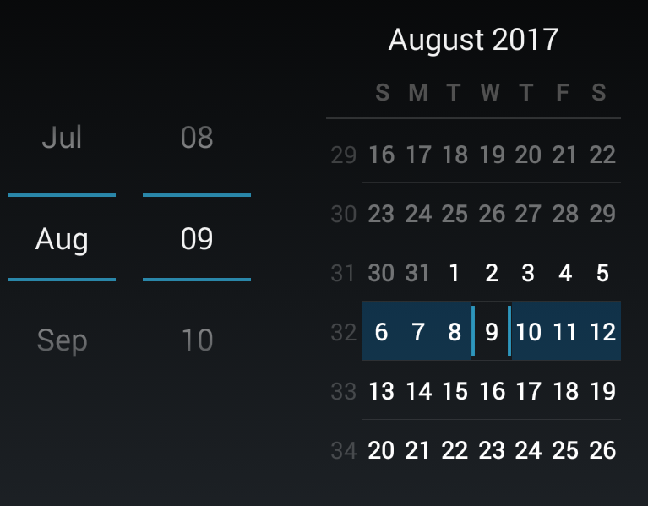
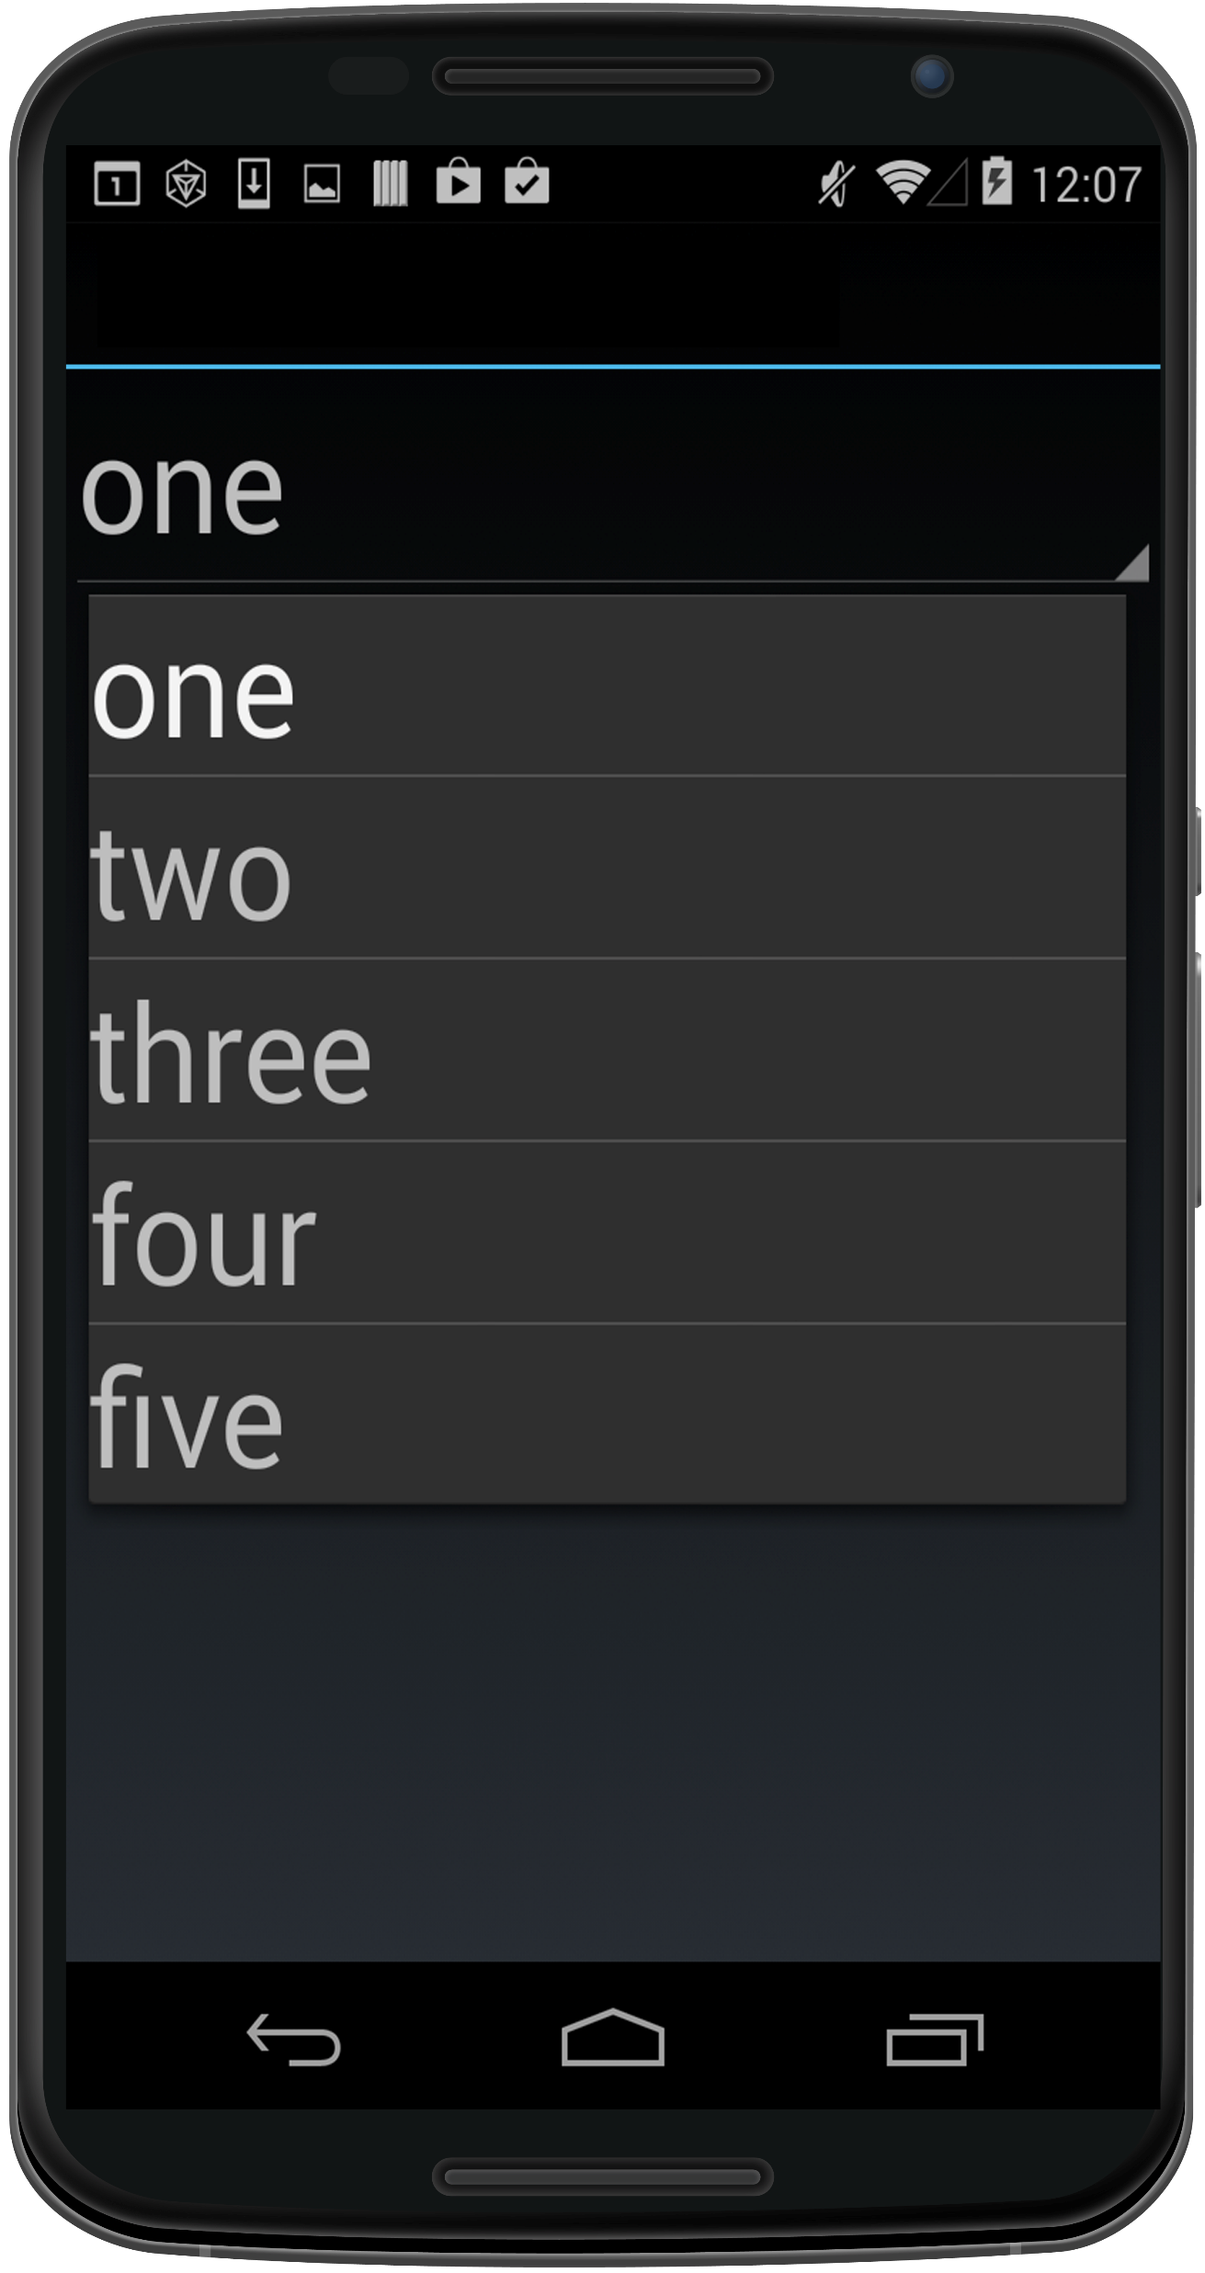
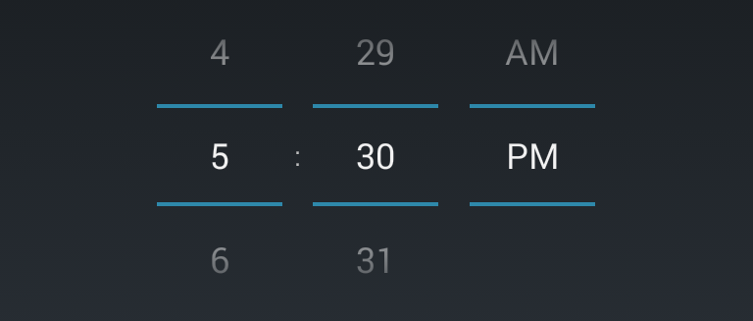
Selection Controls
Spinner DatePicker
TimePicker
Notes:
Notes:
Spinner – a simple drop-down list
DatePicker – selection of month, date, and year
TimePicker– selection of hour, minute, and AM/PM
Images from Xamarin Mobile Application Development by Dan Hermes http://amzn.to/1rowG7K

Slide 27


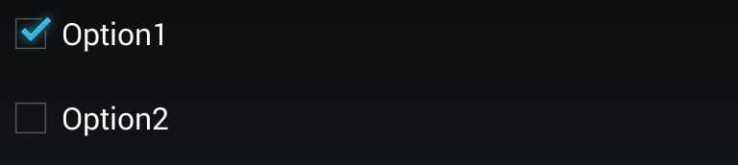
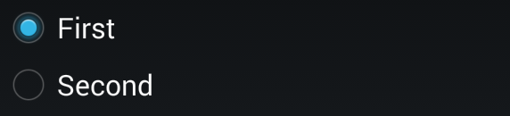
Selection Controls
SeekBar Switch
Checkbox RadioButton
Notes:
Notes:
SeekBar – sliding input lever for continuous values
Checkbox – a standard Boolean checkbox control
Switch – boolean on-or-off switch
RadioButton – button groups for single or multiple selection
References:
Images from Xamarin Mobile Application Development by Dan Hermes http://amzn.to/1rowG7K

Slide 28
Spinner
Notes:
Notes:
Place a Spinner in your layout XML (spinner.axml)
References:
Images from Xamarin Mobile Application Development by Dan Hermes http://amzn.to/1rowG7K

Slide 29
Spinner
<Spinner
android:layout_width="match_parent"
android:layout_height="wrap_content"
android:id="@+id/spinner" />
Notes:
Notes:
Place a Spinner in your layout XML (spinner.axml)

Slide 30
Spinner Cell
<?xml version="1.0" encoding="UTF-8"?>
<TextView xmlns:android="http://schemas.android.com/apk/res/android"
android:id="@+id/textItem"
android:textSize="44sp"
android:layout_width="fill_parent"
android:layout_height="wrap_content" />
Notes:
Notes:
Create another layout that contains a TextView for binding to an Adapter to create a list to display. (TextViewForSpinner.axml)

Slide 31
Spinner Implementation
SetContentView (Resource.Layout.Spinner);
Spinner spinner = FindViewById<Spinner> (Resource.Id.spinner);
string[] options = {"one", "two", "three", "four", "five"} ;
ArrayAdapter adapter = new ArrayAdapter (this, Resource.Layout.TextViewForSpinner,
options);
spinner.Adapter = adapter;
Notes:
Instantiate the spinner in an activity, populate the list, and then bind the list to the Spinner.Adapter property
Handle selection using the Spinner.ItemSelected event.

Slide 32
Summary
In this lesson, you have learned:
To understand Android development fundamentals:
Activity
Life Cycle
Layouts
Views/Controls

